Slide 1

Direct extraction of path weak values from interferograms without auxiliary qubits

Slide 2
Content

Slide 3
Content
Introduction to weak values and weak measurements

Slide 4
Content
Introduction to weak values and weak measurements
Weak values based description of a Mach-Zehnder interferometer

Slide 5
Content
Introduction to weak values and weak measurements
Weak values based description of a Mach-Zehnder interferometer
Experimental measurement of path weak values from interferograms

Slide 6
Introduction to weak values and weak measurement

Slide 7

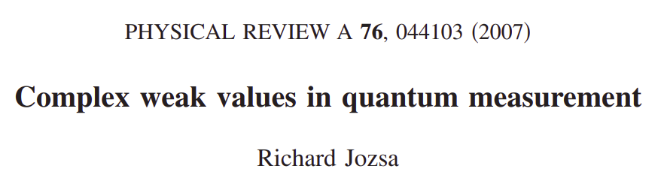
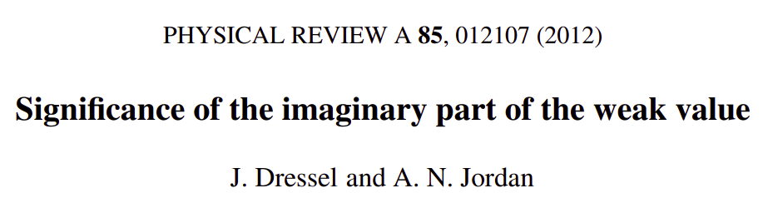

Slide 8


Weak value
Definition:

Slide 9
Weak value
Definition:

Slide 10
Weak value
Observable:
Pre-selected state:
Post-selected State:
Definition:

Slide 11

Weak value
Observable:
Pre-selected state:
Post-selected State:
Definition:
Expectation value:

Slide 12
Weak value
Observable:
Pre-selected state:
Post-selected State:
Complex number
Definition:
Expectation value:

Slide 13
Weak value
Observable:
Pre-selected state:
Post-selected State:
Complex number
Not bounded by eigenvalues
Definition:
Expectation value:

Slide 14
Example of standard measurement
(Von Neumann scheme)

Slide 15
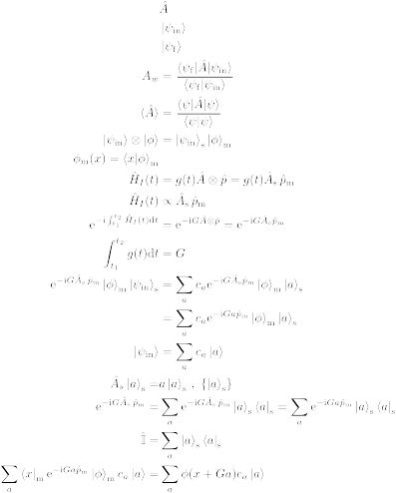
Example of standard measurement
(Von Neumann scheme)
Two quantum states
System
Meter

Slide 16
Example of standard measurement
(Von Neumann scheme)
Two quantum states
System observable

Slide 17
Example of standard measurement
(Von Neumann scheme)
Two quantum states
System observable

Slide 18
Example of standard measurement
(Von Neumann scheme)
Two quantum states
System observable
Interaction Hamiltonian

Slide 19
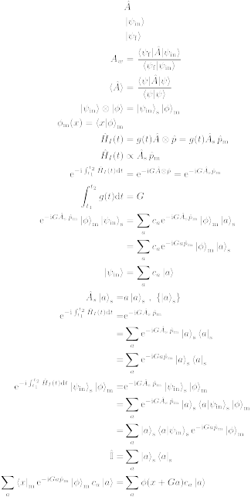
Example of standard measurement
(Von Neumann scheme)
Effect of the interaction Hamiltonian

Slide 20
Example of standard measurement
(Von Neumann scheme)
Effect of the interaction Hamiltonian
Interaction strength

Slide 21
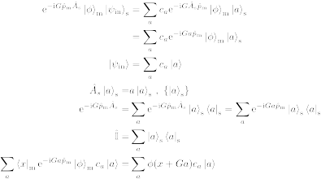
Example of standard measurement
(Von Neumann scheme)
Effect of the interaction Hamiltonian

Slide 22
Example of standard measurement
(Von Neumann scheme)
Effect of the interaction Hamiltonian

Slide 23
Example of standard measurement
(Von Neumann scheme)
Effect of the interaction Hamiltonian

Slide 24
Example of standard measurement
(Von Neumann scheme)
Effect of the interaction Hamiltonian
Translation operator

Slide 25
Example of standard measurement
(Von Neumann scheme)
Takeaway

Slide 26
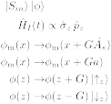
Example of standard measurement
(Von Neumann scheme)
Takeaway
Eigenvalue
Interaction strength

Slide 27


Stern-Gerlach
Spin
Position

Slide 28
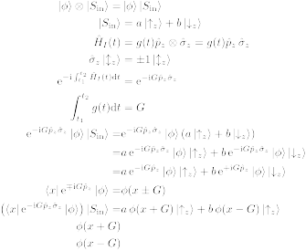
Stern-Gerlach
N
S

Slide 29
Stern-Gerlach
N
S

Slide 30
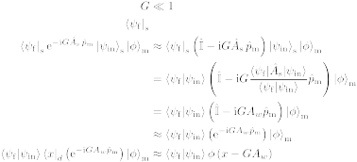
Weak measurement
Effect of the interaction Hamiltonian

Slide 31
Weak measurement
Effect of the interaction Hamiltonian

Slide 32
Weak measurement
Effect of the interaction Hamiltonian
Post-selection

Slide 33
Weak measurement
Effect of the interaction Hamiltonian

Slide 34
Weak measurement
Effect of the interaction Hamiltonian
Weak value of

Slide 35
Weak measurement
Effect of the interaction Hamiltonian

Slide 36
Weak measurement
Effect of the interaction Hamiltonian
Translation operator

Slide 37
Weak measurement
Takeaway

Slide 38
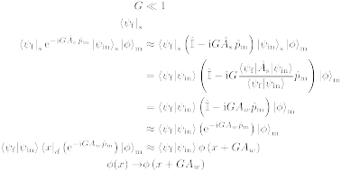
Weak measurement
Takeaway
Weak value
Interaction strength

Slide 39
Stern-Gerlach weak measurement

Slide 40
Stern-Gerlach weak measurement
N
S

Slide 41
Stern-Gerlach weak measurement
N
S

Slide 42
Stern-Gerlach weak measurement
N
S

Slide 43
Stern-Gerlach weak measurement
N
S

Slide 44
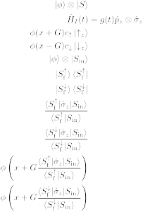
Stern-Gerlach weak measurement
N
N
S
S

Slide 45

Stern-Gerlach weak measurement
Spin weak value:
N
N
S
S

Slide 46
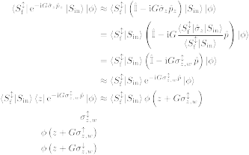
Stern-Gerlach weak measurement
N
N
S
S

Slide 47
First paper on weak values

Slide 48
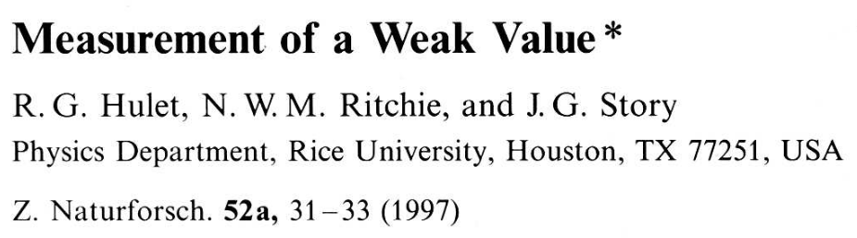
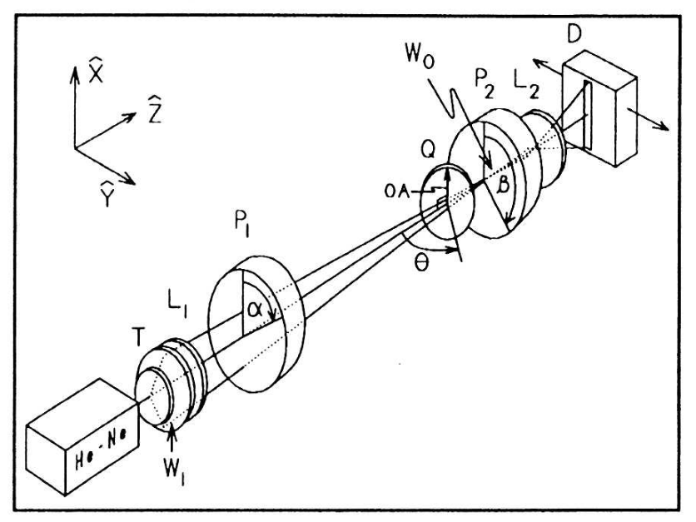
First measurement of weak values

Slide 49
What is it good for?

Slide 50
Theory and experiment
Quantum amplification
Uncertainty relations
Negative quasi-probability distributions
Quantum paradoxes

Slide 51
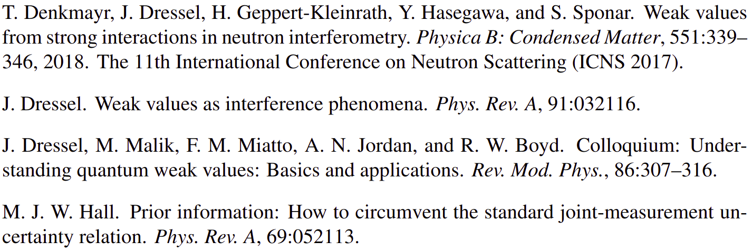
Theory and experiment
Quantum amplification
Uncertainty relations
Negative quasi-probability distributions
Quantum paradoxes
And more...

Slide 52
“In between” evolution of a system
Minimal disturbance
Non-commuting observables

Slide 53
“In between” evolution of a system
N
N
S
S

Slide 54



“In between” evolution of a system
Two level system = spinor

Slide 55

“In between” evolution of a system
Two level system = spinor
“Spin” state

Slide 56
“In between” evolution of a system
Two level system = spinor
“Spin” state

Slide 57
“In between” evolution of a system
Two level system = spinor
“Spin” state
“Spin”
projection

Slide 58
CAN WEAK VALUES DESCRIBE INTERFEROMETRY?

Slide 59
DO WE ACTUALLY NEED A WEAK MEASUREMENT?

Slide 60
Weak value
Definition:

Slide 61
Weak values and interferometry
Standard interferometry formalism

Slide 62
Weak values and interferometry
Standard interferometry formalism

Slide 63
Weak values and interferometry
Standard interferometry formalism

Slide 64
Weak values and interferometry
Standard interferometry formalism

Slide 65
Weak values and interferometry
Standard interferometry formalism

Slide 66

Weak values and interferometry
Standard interferometry formalism
Measured intensity

Slide 67
Weak values and interferometry
Standard interferometry formalism
Measured intensity

Slide 68
Weak values and interferometry
Standard interferometry formalism
Measured intensity

Slide 69
Weak values and interferometry
Standard interferometry formalism
Measured intensity

Slide 70
Weak values and interferometry
Weak value picture
Pre-selection

Slide 71
Weak values and interferometry
Weak value picture
Pre-selection
Interaction

Slide 72

Weak values and interferometry
Weak value picture
Pre-selection
Interaction

Slide 73
Weak values and interferometry
Weak value picture
Pre-selection
Interaction
Post-selection

Slide 74
Weak values and interferometry
Weak value picture
Measured intensity

Slide 75
Weak values and interferometry
Weak value picture
Measured intensity

Slide 76
Weak values and interferometry
Weak value picture
Measured intensity

Slide 77
Weak values and interferometry
Weak value picture
Measured intensity
Path weak value

Slide 78
Weak values and interferometry
Weak value picture
Measured intensity

Slide 79
Weak values and interferometry
Weak value picture
Measured intensity

Slide 80
Weak values and interferometry
Weak value picture
Measured intensity

Slide 81
Weak values and interferometry
Weak value picture
Measured intensity
Amplitude
square

Slide 82
Weak values and interferometry
Weak value picture
Measured intensity
Real part
Amplitude
square

Slide 83
Weak values and interferometry
Weak value picture
Measured intensity
Real part
Amplitude
square
Imaginary
part

Slide 84
Weak values and interferometry
Weak value picture
Measured intensity

Slide 85

Weak values and interferometry
Weak value picture
Measured intensity

Slide 86
Weak values and interferometry
Weak value picture
Measured intensity

Slide 87
Weak values and interferometry
Weak value picture
Measured intensity

Slide 88
Weak values and interferometry
Weak value picture
Measured intensity

